Slide 1
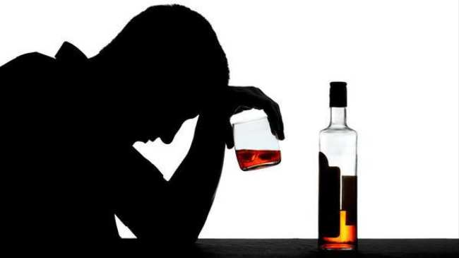
ALCOHOL
THE ENEMY OF HEALTH, WORK & LIFE
Made by: Chandanaa Pathirana
Group no: 56
4th Course

Slide 2
PLAN
IMPORTANCE OF THE ISSUE
WHY PEOPLE USE ALCOHOL
HOW MANY PEOPLE USE ALCOHOL
IMPACT OF ALCOHOLISM ON OTHERS
HOW ALCOHOL AFFECTS YOUR HEALTH
CONSEQUENCES OF ALCOHOL CONSUMPTION
PREENTION

Slide 3
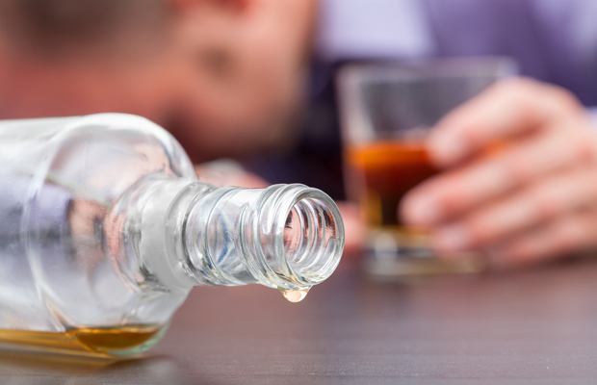
WHY IS THIS ISSUE IMPORTANT?
For years, alcohol has been a part of social gatherings, celebrations, and rituals. Addiction to alcohol is more of a problem today than it has ever been in the past. Unlike a century ago, we are now aware of the serious complications it can cause.

Slide 4
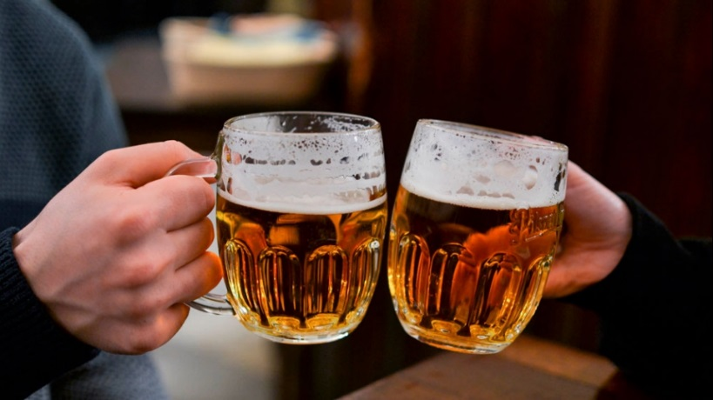
WHY PEOPLE DRINK ALCOHOL?
To feel relaxed
To look cool
To forget problems
To join the party
To have fun during the holidays
To enjoy sporting events
To become intoxicated

Slide 5
HOW MANY PEOPLE DO YOU THINK THAT DRINKS ALCOHOL?

Slide 10
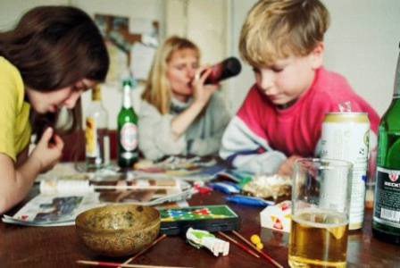
HOW DOES ALCOHOL IMPACT OTHERS?
Kids look up to their parents or to their siblings. When they see they are having fun drinking with their buddies or when they see an advertisement of alcohol, they’ll misunderstand the message of alcohol and think it is good for them.

Slide 11
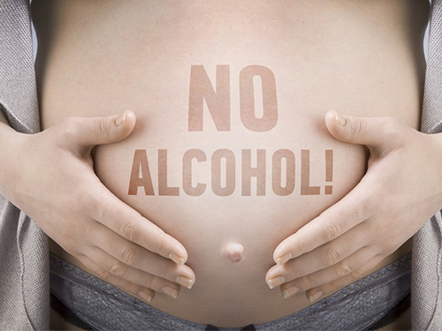
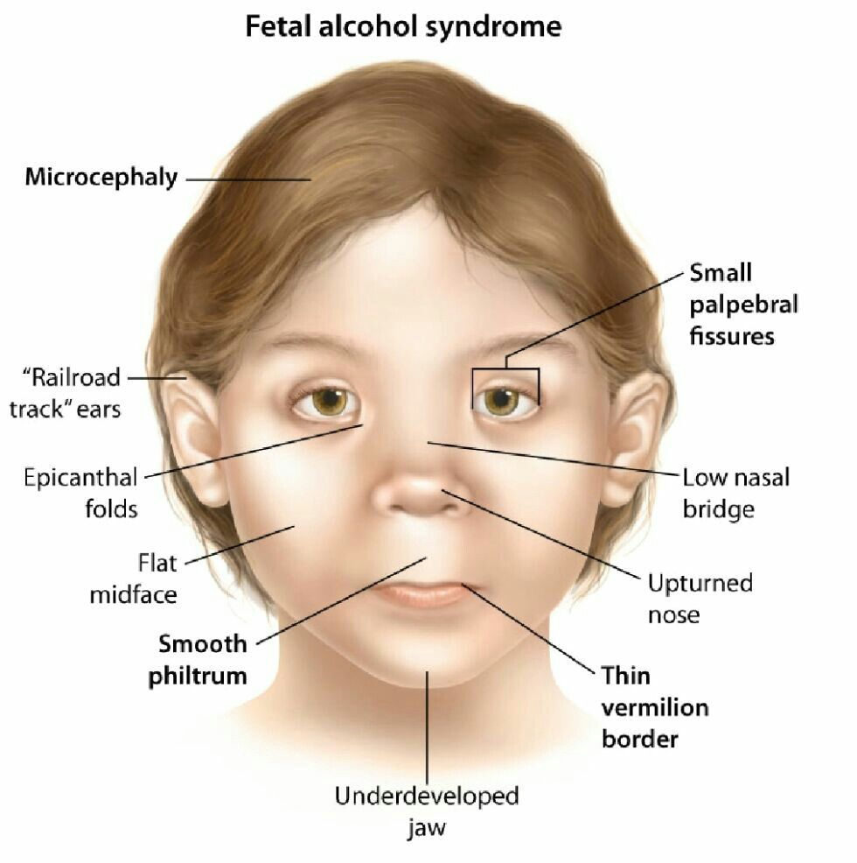
Fetal alcohol syndrome
A serious problem that can develop in the fetus of women who drink during pregnancy.

Slide 12
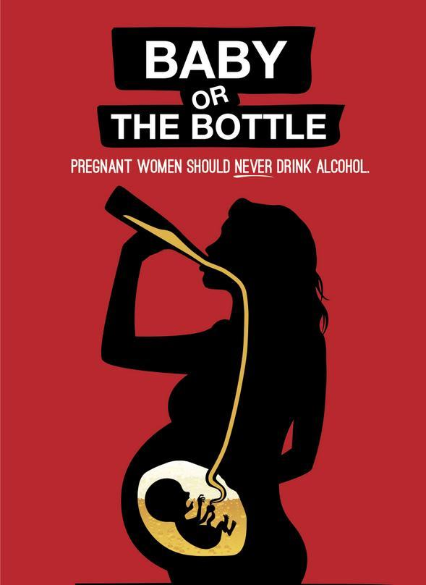
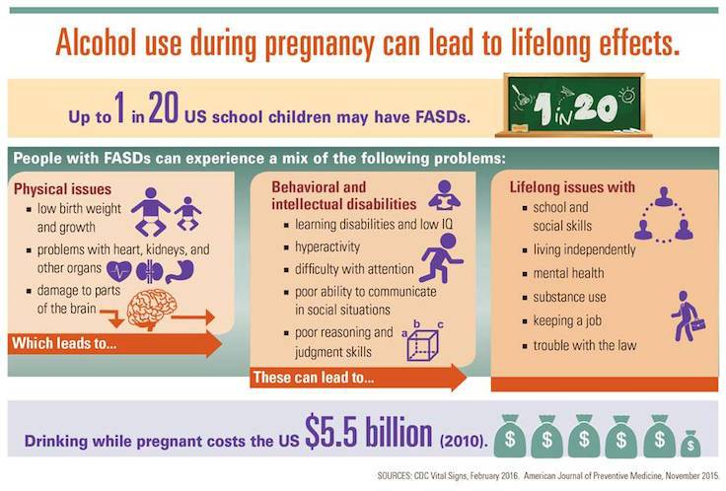

Slide 13
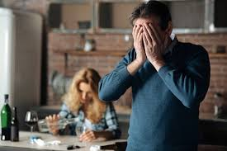
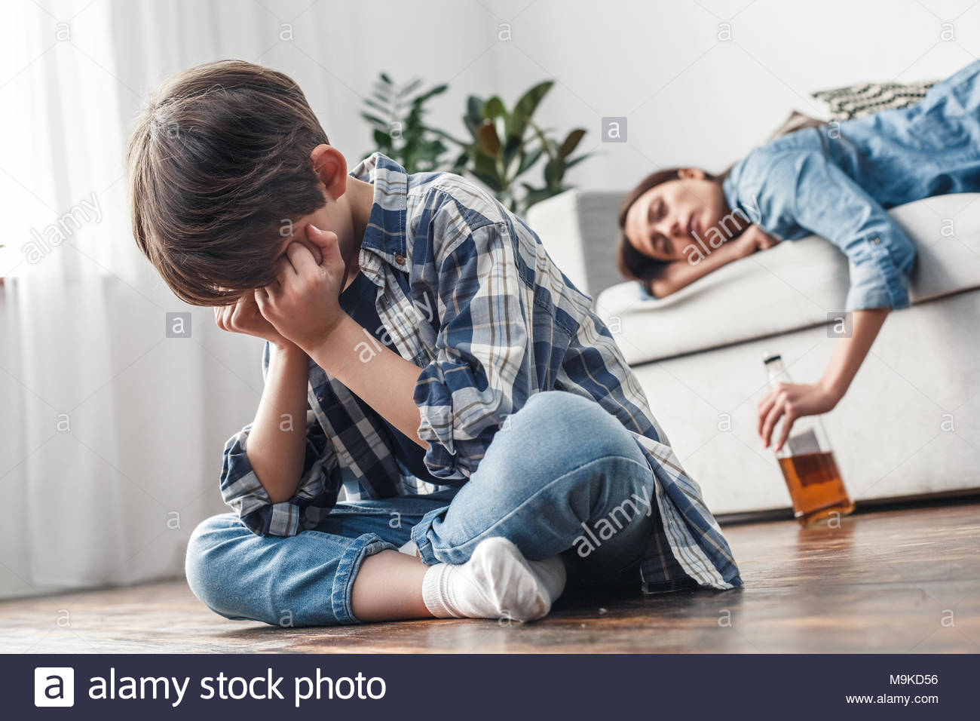
Outbursts of emotions can cause the alcoholic person to be violent and harms other people around him/her.

Slide 14
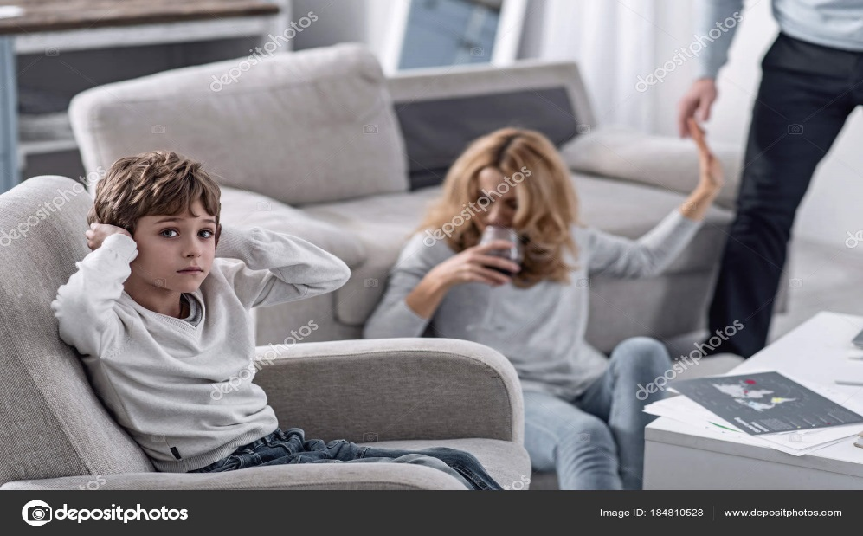
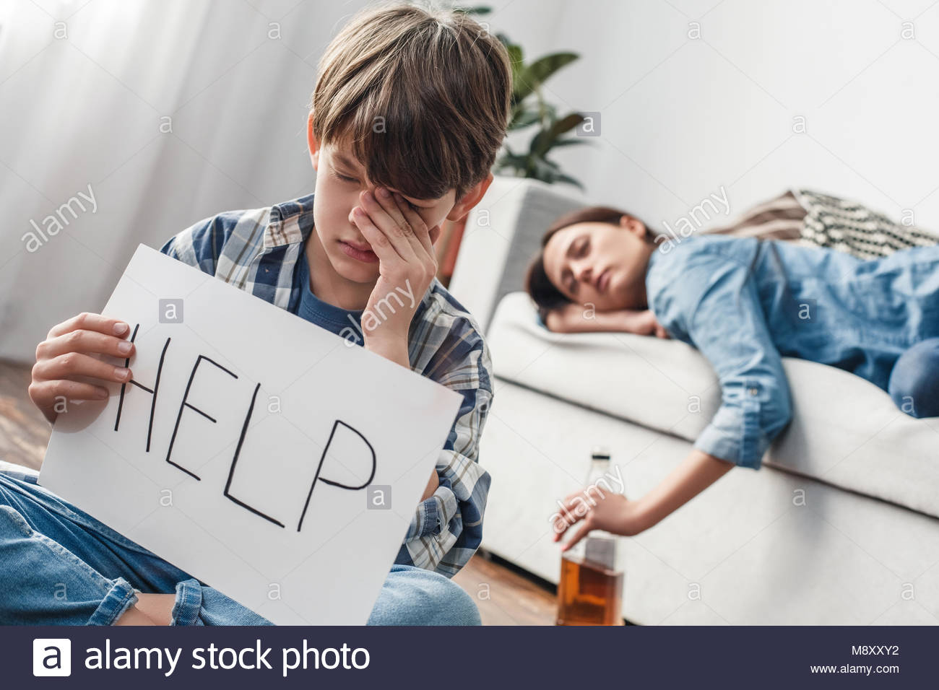
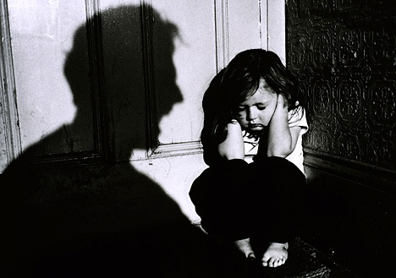
Children whose parents abuse alcohol and other drugs are three times more likely to be abused and more than four times more likely to be neglected than children from non-abusing families.

Slide 15
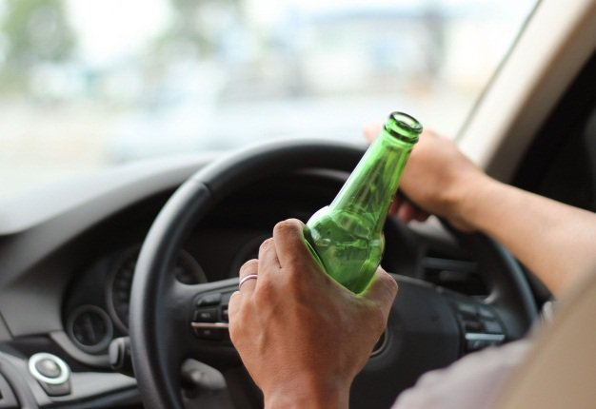
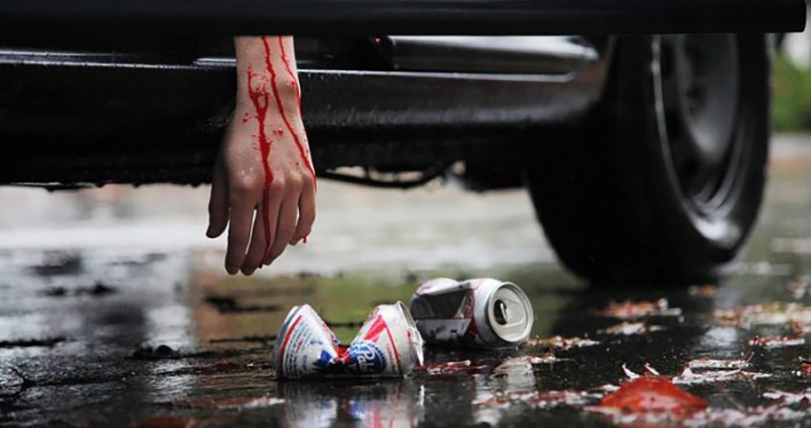
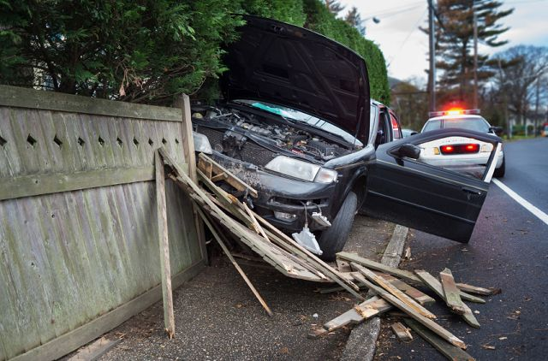
Driving while intoxicated can cause serious problems on the road. The intoxicated drier can crash on to someone else and chances are they both will die, just one of them, or by miracle…. They just survive with bruises.

Slide 16
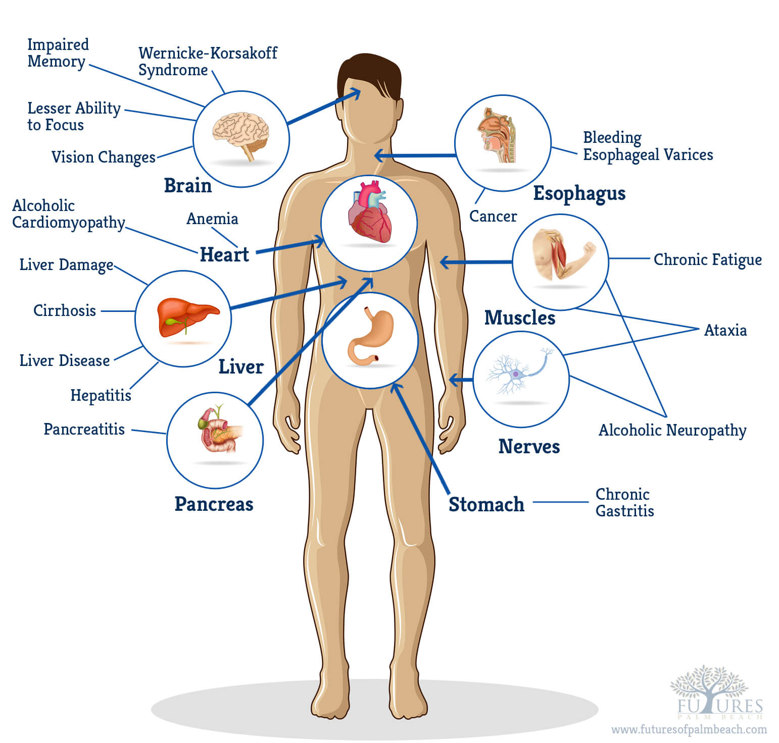
WHAT CAN ALCOHOL DAMAGE?

Slide 17
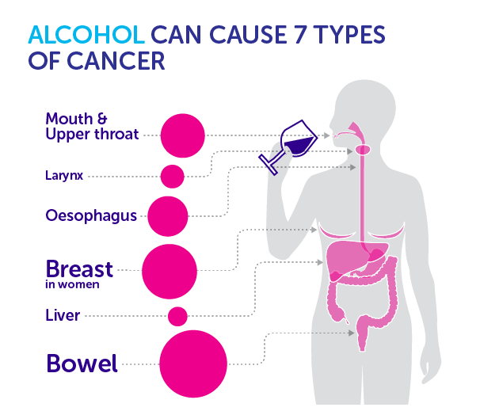

Slide 18
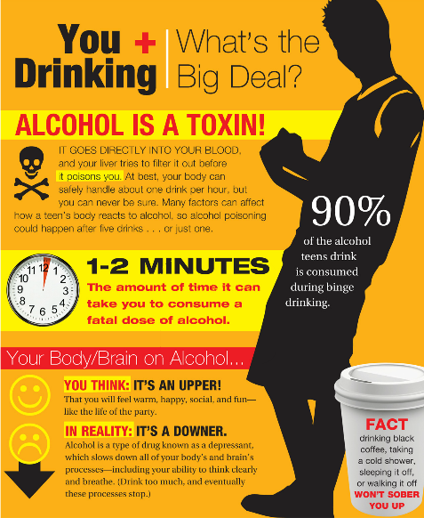
IMMEDIATE EFFECTS
Blurred vision
Slurred speech
Increased heart beat
Lowers body temperature
Vomiting
Hangover
Alcohol poisoning (death)

Slide 19
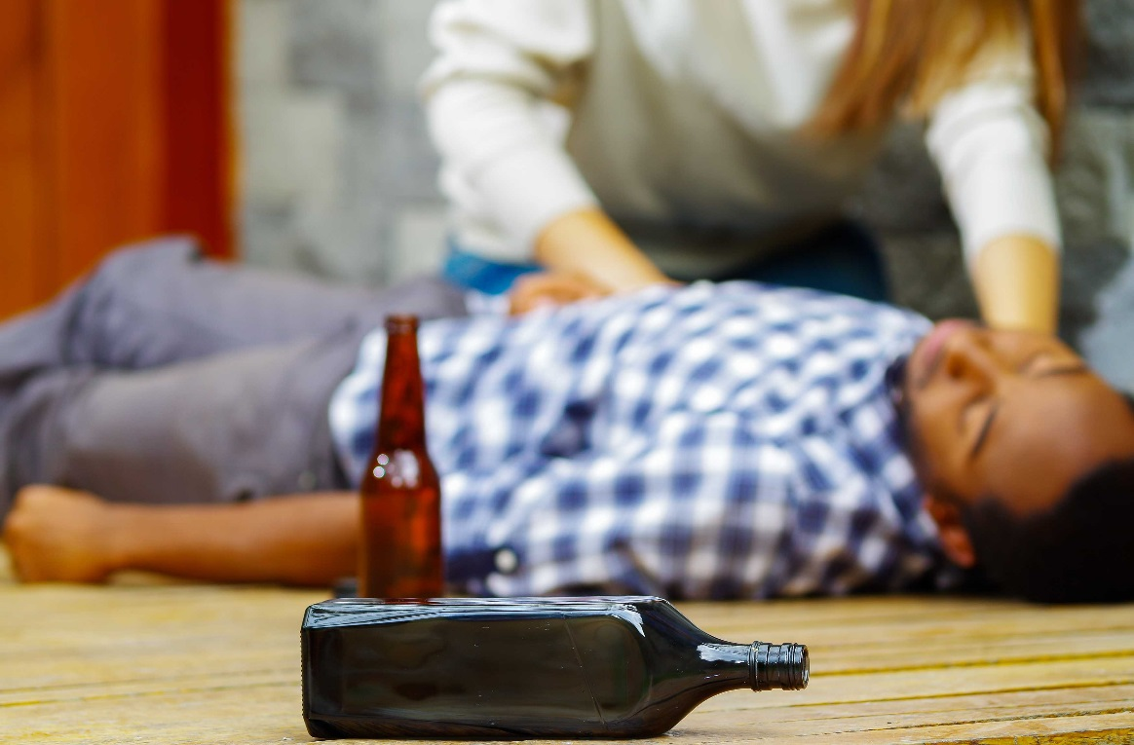
SYMPTOMS ALCOHOL CAN CAUSE
Serious medical conditions:
cancer
Depression
Heart and respiratory failure
Cirrhosis
Wernickle- Korsakoff syndrome
AND MANY MORE…..

Slide 20
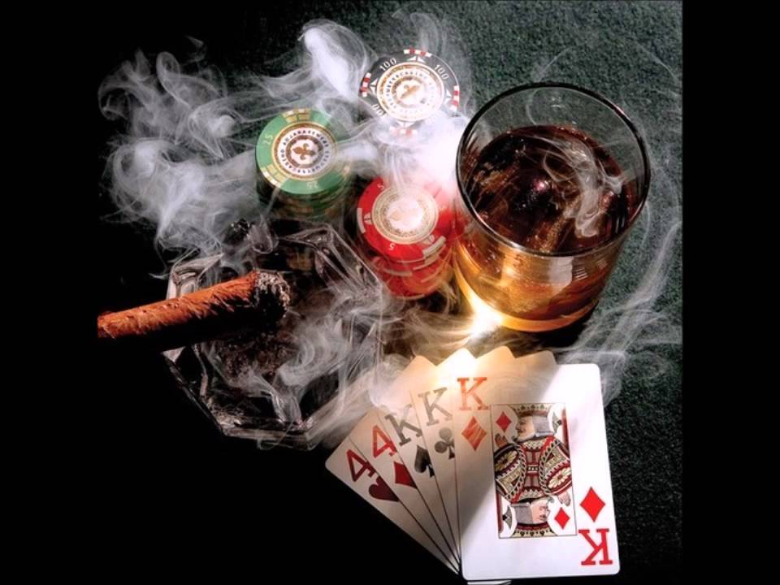
MORE PROBLEMS ALCOHOL CAN CAUSE
Debts
Drugs
Vandalism
More expensive habits such as gambling
Unprotected intercourse under the influence of alcohol can lead to unwanted pregnancies or STDs.

Slide 21
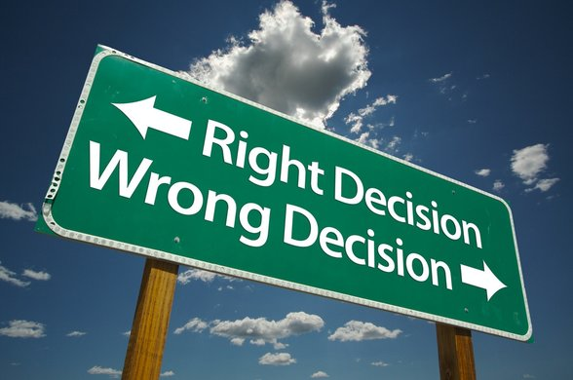
Being under the right influence of alcohol makes you lose sight of what’s right or wrong.

Slide 22
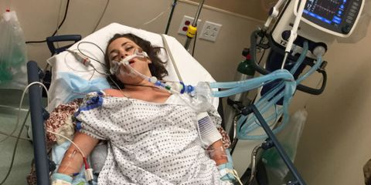
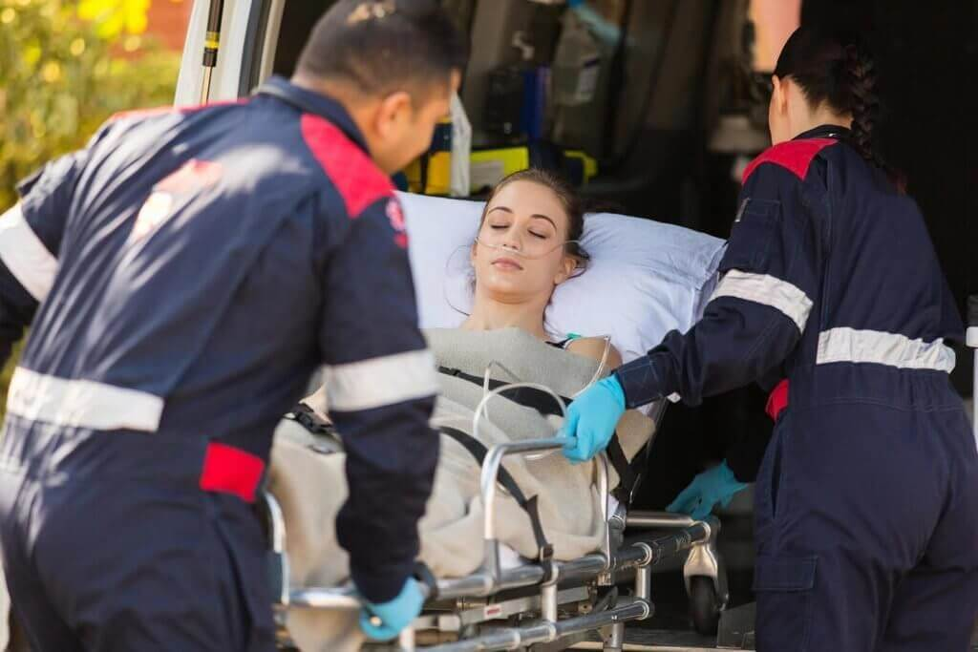
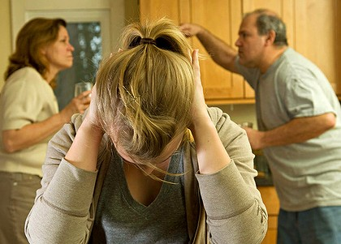
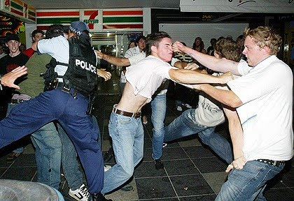
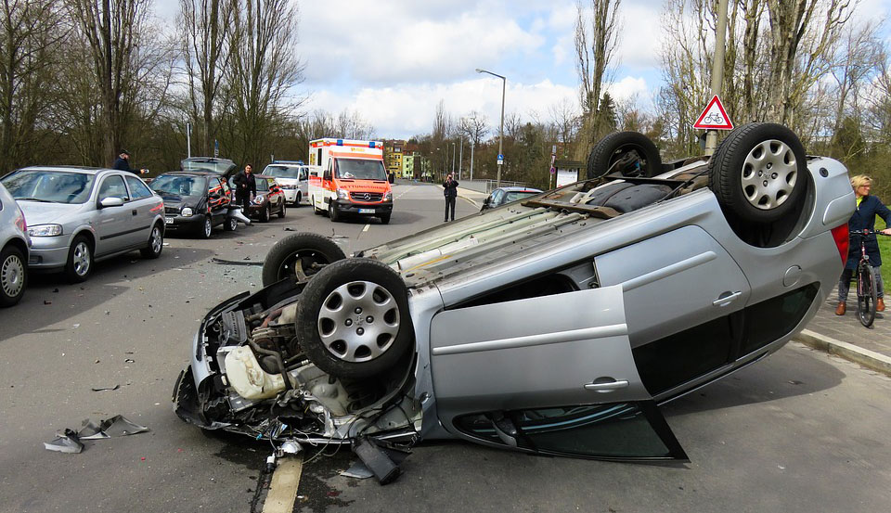
These guys learned the hard way.
Do you want to be like them?

Slide 23
WHAT CAN YOU DO TO PREVENT YOURSELF FROM DRINKING?
Volunteer in any community activities
Develop personal, social, and resistance skills
Take more extracurricular activities from school
OR
DRINK RIGHT

Slide 24
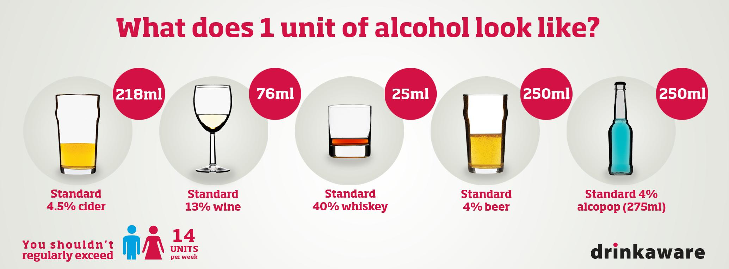

Slide 25
WHAT CAN YOU DO TO HELP THIS ISSUE?
Persuade others not to take any alcohol
Tell your friends about the consequences of alcohol
Be a role model to your relatives and friends
Don’t drink alcohol. One less drunkard makes a difference.

Slide 26
REFERENCES
https://www.quitalcohol.com/the-truth-about-what-alcohol-does-to-your-body.html
https://scienceblog.cancerresearchuk.org/2018/01/03/alcohol-and-cancer-this-is-how-booze-damages-dna-inside-cells/
https://www.womansday.com/health-fitness/a53381/hanna-lottritz-binge-drinking-alcohol-poisoning/
https://alcorehab.org/alcoholism/statistics/
https://en.wikipedia.org/wiki/Alcoholism

